Slide 1
Lecture Notes – BSCS 5th Semester Course: Digital Image Processing Instructor: Adnan Majeed Topic: Point-Based Image Processing

Slide 2
1. Introduction
Point-Based Image Processing is a fundamental technique in digital image processing where each pixel in the input image is processed independently to produce an output image.
The transformation of the pixel depends only on its own value, not on neighboring pixels.
Also known as Point Operations or Intensity Transformations.
Widely used for contrast enhancement, brightness adjustment, thresholding, etc.

Slide 3
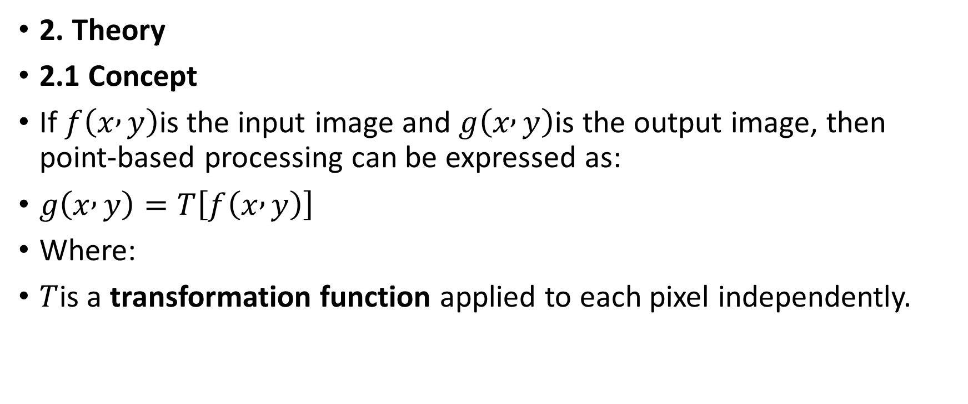
2. Theory
2.1 Concept
If $f\left(x , y\right)$is the input image and $g\left(x , y\right)$is the output image, then point-based processing can be expressed as:
$g\left(x , y\right)=T\left[f\left(x , y\right)\right]$
Where:
$T$is a transformation function applied to each pixel independently.

Slide 4
2.2 Applications
Brightness and Contrast Adjustment
Image Negative
Logarithmic Transformations
Power-Law (Gamma) Transformations
Thresholding (Binarization)
Bit-Plane Slicing

Slide 5
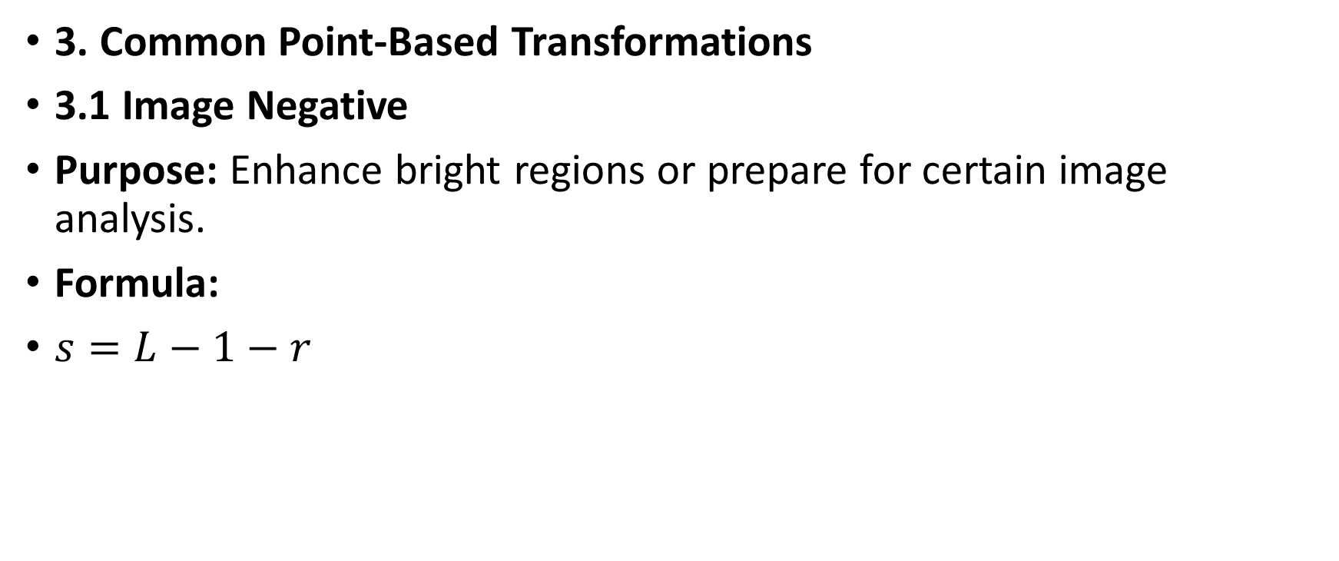
3. Common Point-Based Transformations
3.1 Image Negative
Purpose: Enhance bright regions or prepare for certain image analysis.
Formula:
$s=L−1−r$

Slide 6
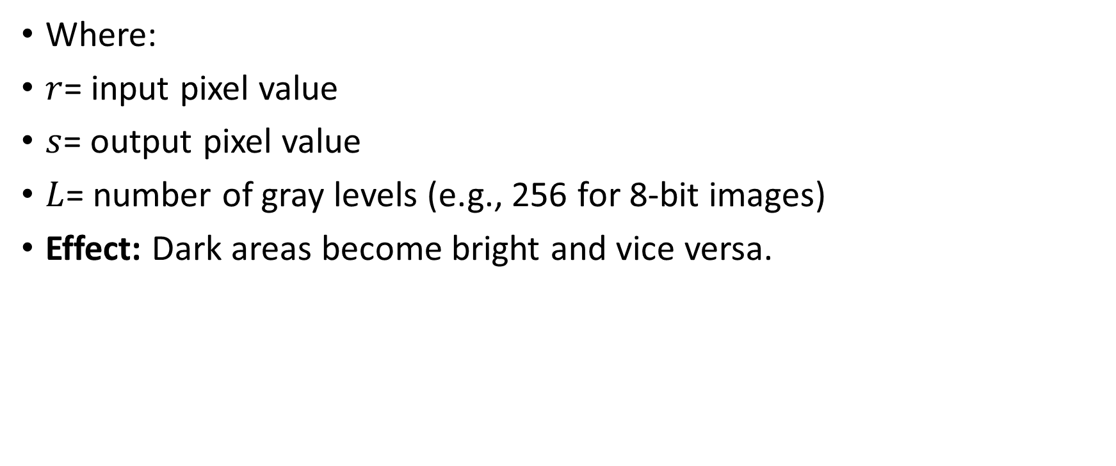
Where:
$r$= input pixel value
$s$= output pixel value
$L$= number of gray levels (e.g., 256 for 8-bit images)
Effect: Dark areas become bright and vice versa.

Slide 7
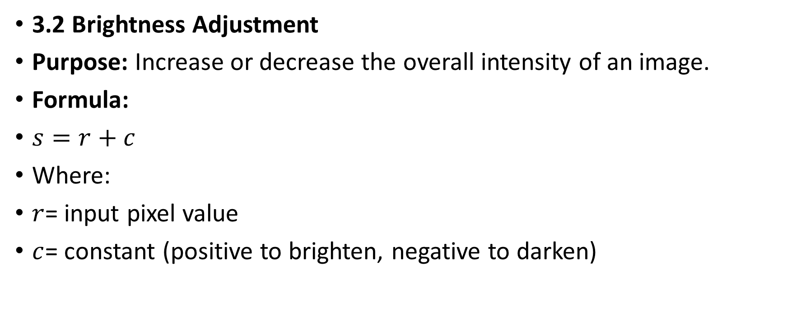
3.2 Brightness Adjustment
Purpose: Increase or decrease the overall intensity of an image.
Formula:
$s=r+c$
Where:
$r$= input pixel value
$c$= constant (positive to brighten, negative to darken)

Slide 8
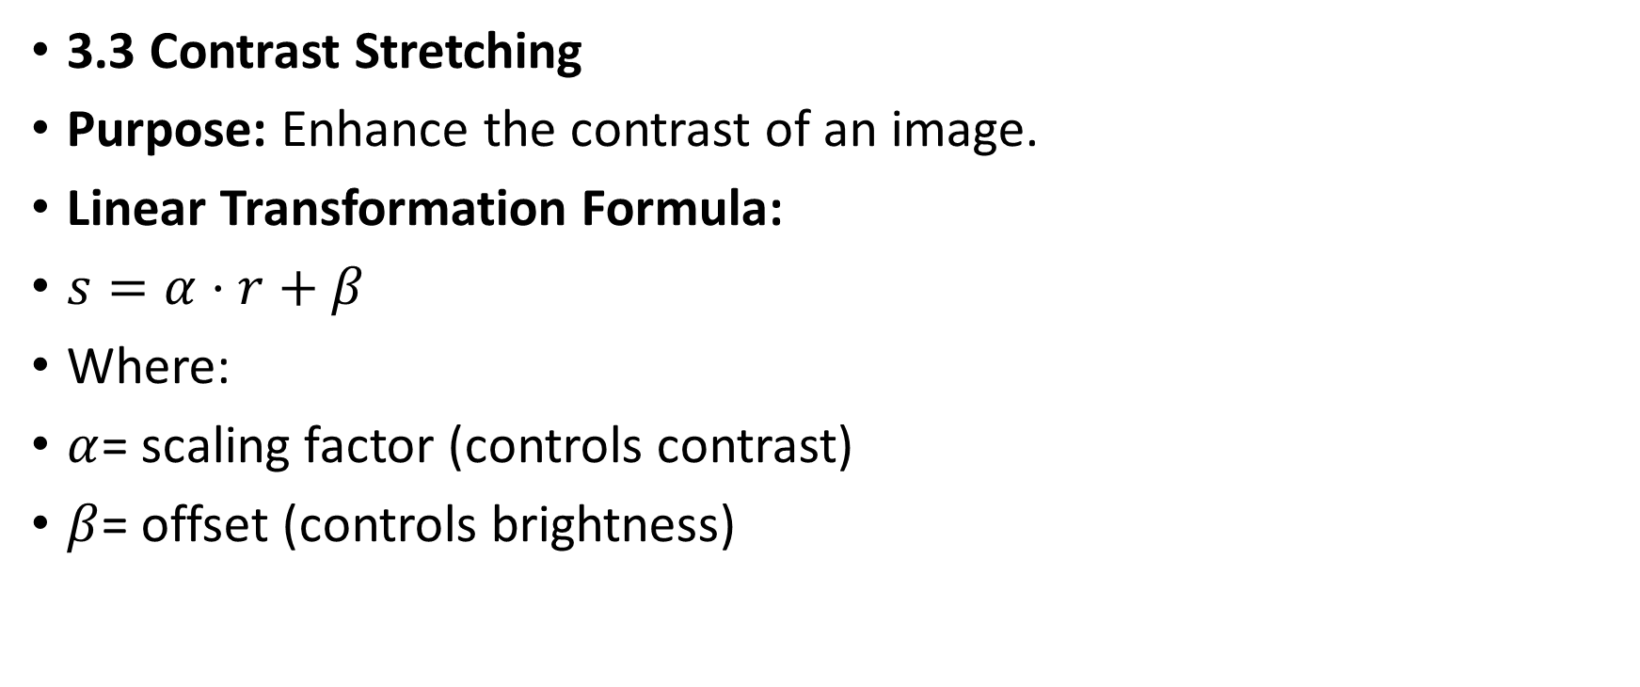
3.3 Contrast Stretching
Purpose: Enhance the contrast of an image.
Linear Transformation Formula:
$s=α⋅r+β$
Where:
$α$= scaling factor (controls contrast)
$β$= offset (controls brightness)

Slide 9
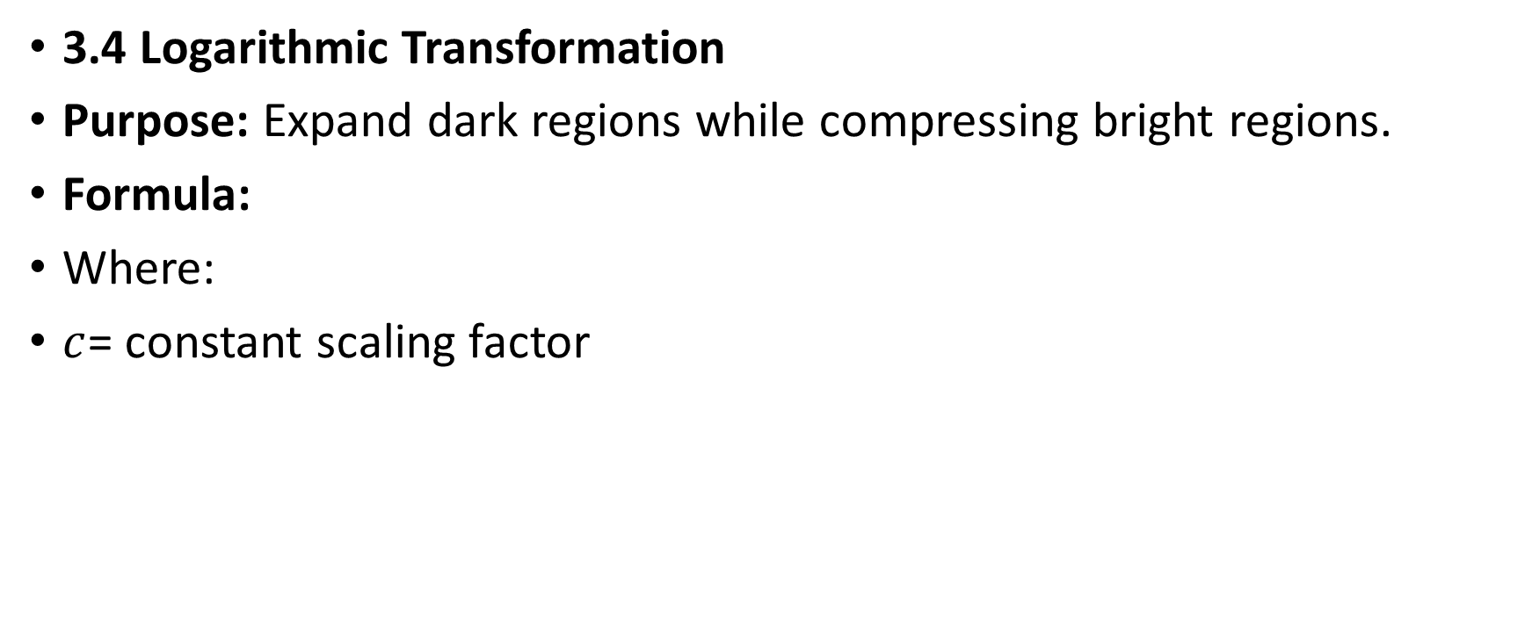
3.4 Logarithmic Transformation
Purpose: Expand dark regions while compressing bright regions.
Formula:
Where:
$c$= constant scaling factor

Slide 10
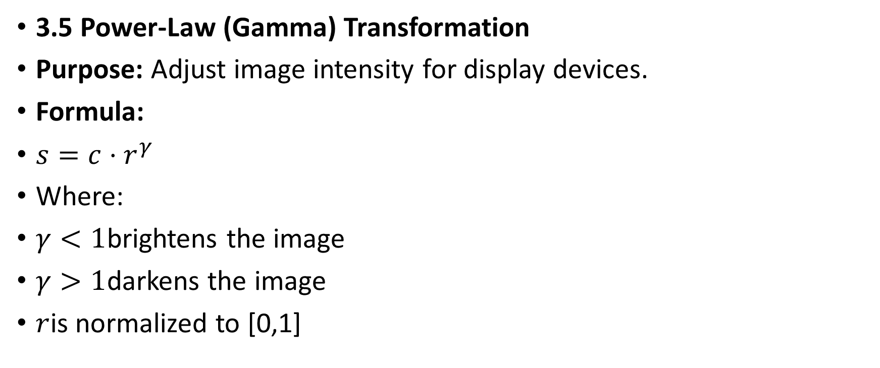
3.5 Power-Law (Gamma) Transformation
Purpose: Adjust image intensity for display devices.
Formula:
$s=c⋅r^{γ}$
Where:
$γ<1$brightens the image
$γ>1$darkens the image
$r$is normalized to [0,1]

Slide 11
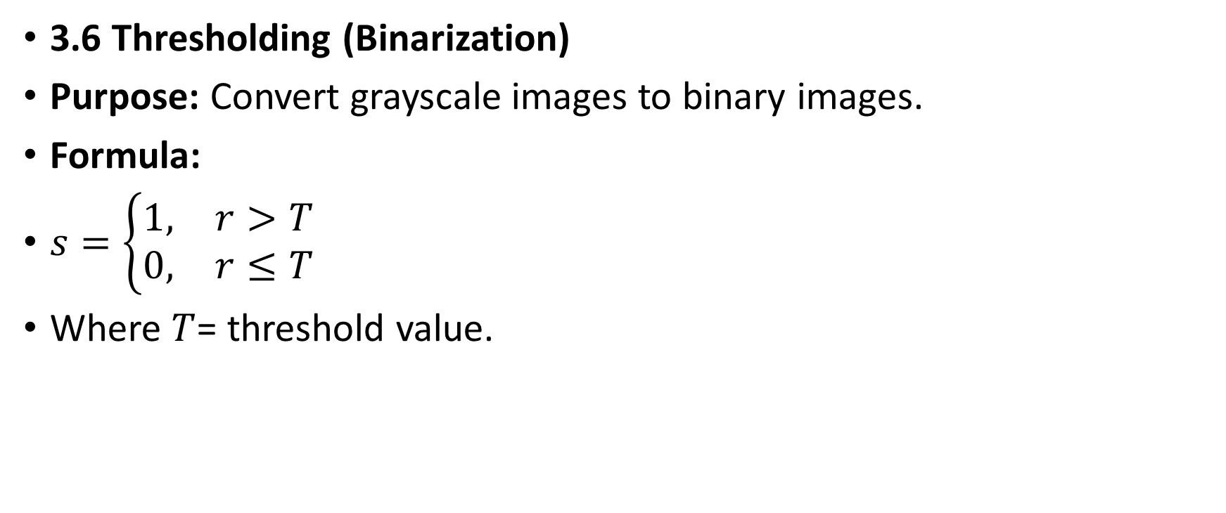
3.6 Thresholding (Binarization)
Purpose: Convert grayscale images to binary images.
Formula:
$s=\left\{\begin{matrix}1, & r>T \\ 0, & r≤T\end{matrix}\right.$
Where $T$= threshold value.

Slide 12
3.7 Bit-Plane Slicing
Purpose: Analyze or enhance particular bits of an image.
Each bit-plane of an 8-bit image corresponds to a different significance level of intensity.

Slide 13
4. Steps of Point-Based Image Processing
Step 1: Read the Image
Load the grayscale or color image into the program.
Represent it as a 2D array of pixel values.
Step 2: Choose a Transformation Function
Decide which point operation to apply:
Negative
Brightness/Contrast
Logarithmic
Gamma
Thresholding

Slide 14
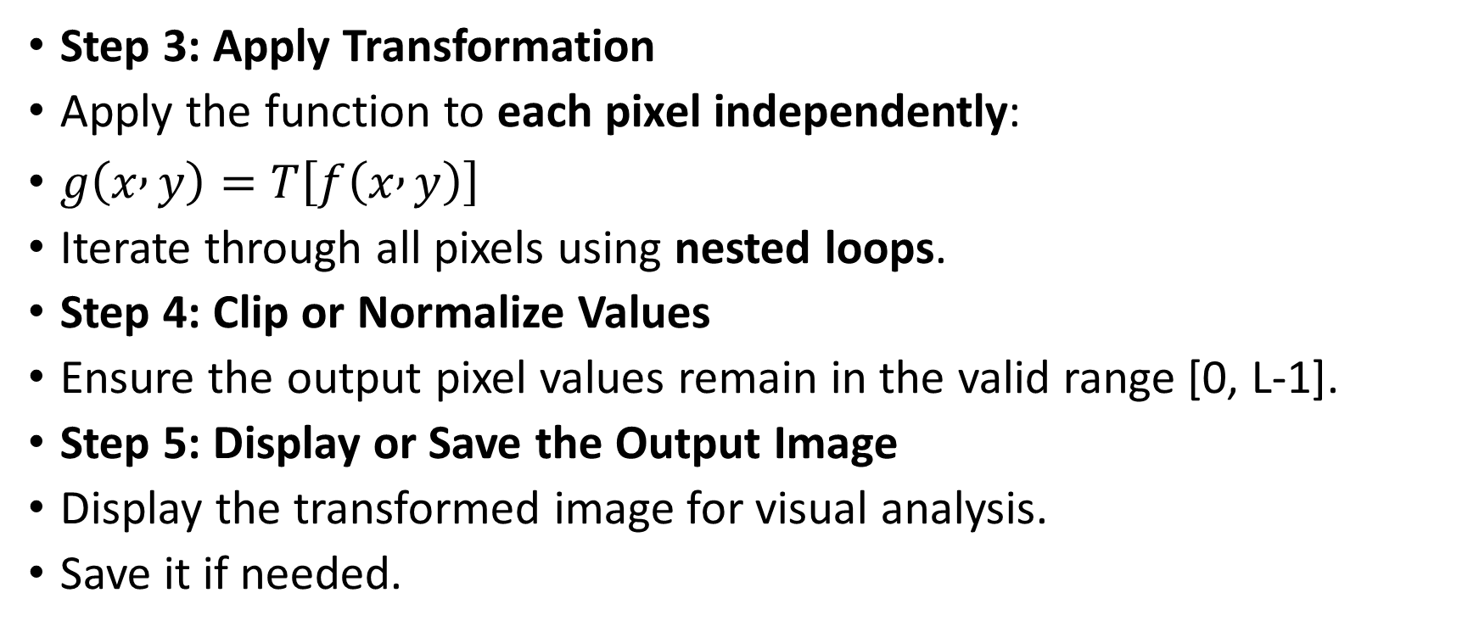
Step 3: Apply Transformation
Apply the function to each pixel independently:
$g\left(x , y\right)=T\left[f\left(x , y\right)\right]$
Iterate through all pixels using nested loops.
Step 4: Clip or Normalize Values
Ensure the output pixel values remain in the valid range [0, L-1].
Step 5: Display or Save the Output Image
Display the transformed image for visual analysis.
Save it if needed.

Slide 15
5. Example in Python (Conceptual)
import cv2
import numpy as np
# Step 1: Load Image
img = cv2.imread(r"E:\env\messaging_app\opencv\flower.jpg", 0)
if img is None:
print("Error: Image not found. Check the file path.")
exit()
# Step 2: Apply Negative Transformation
negative_img = 255 - img
# Step 3: Brightness Adjustment
bright_img = cv2.add(img, 50) # Increase intensity by 50

Slide 16
# Step 4: Gamma Correction
gamma = 1.5
gamma_img = np.array(255*(img/255)**gamma, dtype='uint8')
# Step 5: Display Images
cv2.imshow('Original', img)
cv2.imshow('Negative', negative_img)
cv2.imshow('Bright', bright_img)
cv2.imshow('Gamma Corrected', gamma_img)
cv2.waitKey(0)
cv2.destroyAllWindows()

Slide 17
6. Summary Table
Transformation | Formula | Purpose
Negative | s = L-1-r | Invert intensities
Brightness | s = r+c | Make image brighter/darker
Contrast Stretch | s = αr+β | Enhance contrast
Log Transform | s = c·log(1+r) | Expand dark regions
Gamma | s = c·r^γ | Adjust intensity for display
Threshold | s = 1 if r>T else 0 | Binarize image
Bit-Plane | Extract nth bit | Highlight intensity details

Slide 18
7. Applications of Point-Based Processing
Medical imaging enhancement
Satellite and aerial image enhancement
Document image preprocessing
Preprocessing for further image analysis (edge detection, segmentation)

Slide 19
8. Lab/Assignment Task
Task 1: Apply negative, brightness adjustment, and gamma correction to a grayscale image and display all three results.
Task 2: Perform thresholding on a grayscale image using a chosen threshold.
Task 3: Extract bit-planes 1, 4, and 7 of an 8-bit image and analyze visual differences.

